Slide 1


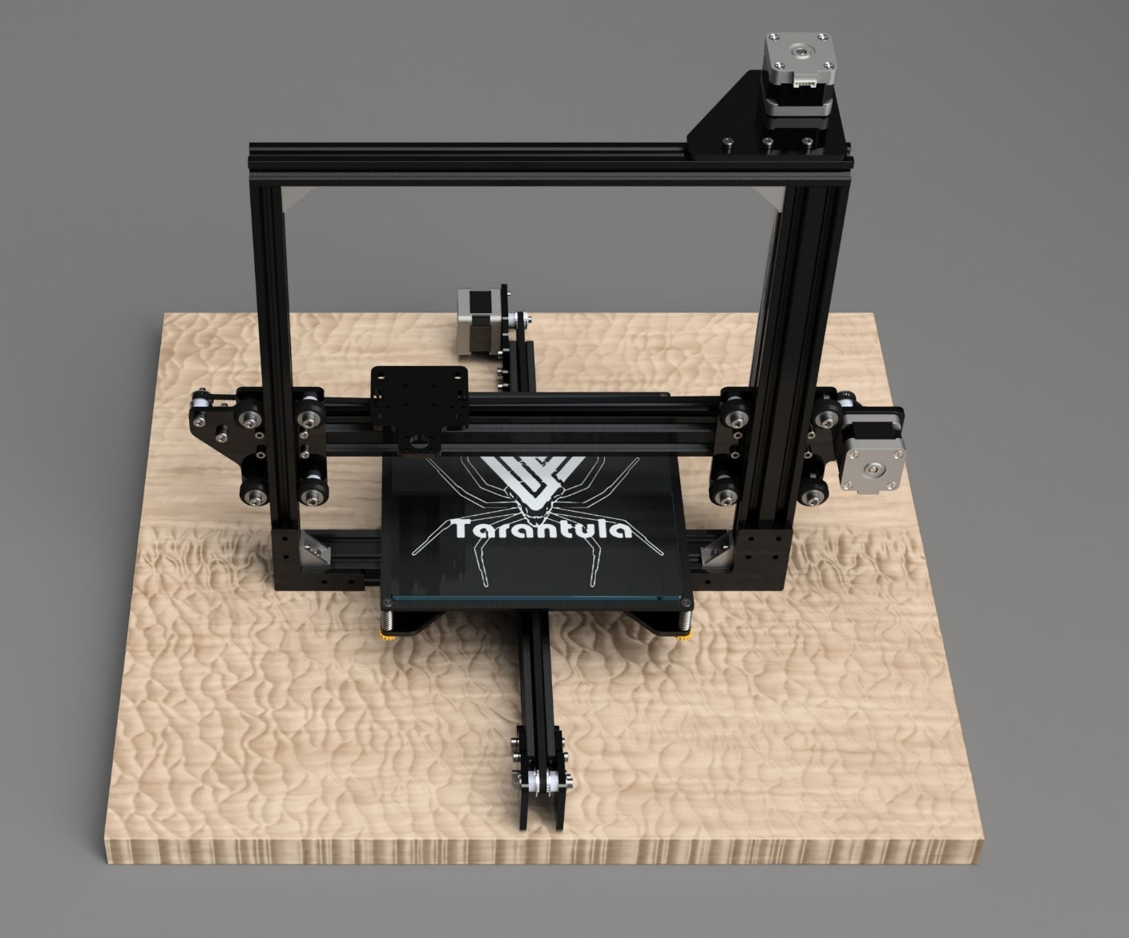
POSTER PRESENTATION EXIBITION
Multi tool CNC Station
Akshay kurhade,Prachi Gore,Onkar Tanade,Prof.R.D.Maknikar
Dept. of Electronics & Telecommunication, MESCOE, Savitribai Phule Pune University, Pune, INDIA.
prachigore777@gmail.com, a.kurhade621@gmail.com, onkartanwde27@gmail.com,
rushikesh.maknikar@mescoepune.org
INTRODUCTION
Traditionally all CNC stations have been standalone systems i.e. a different setup for every specific operation (milling, drilling, extrusion, etc.) It’s becoming an increasing need to develop integrated systems that can-do multitasking. This is needed primarily due to two major reasons. Space constraints, CNC setups usually take up a huge space for single machining setup. Multiple machining processes require a huge space which becomes impossible for small manufacturing units or educational setups to afford. Cost constraints, individual CNC setups cost a huge sum of money for different setups for every single operation. For example, a milling setup requires around a INR 1 lakh setup, a drilling setup the same amount, the 3d extrusion setup similar amount. Thus, making it a huge sum. These constraints make the traditional systems unusable for prototyping stages, where it is actually required but is unaffordable. Therefore, it’s becoming a need of the hour to develop multitasking systems, which can not only help in the space and cost constraints but also save the valuable resources.
INTRODUCTION
The multi tool setup consists of a modular head which helps in easily interchanging the modular tools specifically designed for the setup. The modular carriage is mounted on a 3-axis (cartesian) moving setup using NEMA 17 bipolar stepper motors. The whole setup is controlled using MKS GENv1.4 board. This is a general-purpose breakout board which is specially designed for 3d printers but can be configured for other applications too. A computer may or may not be connected to the setup. A computer can be used to directly print and monitor jobs although the setup can work even in the absence of a computer. A single board computer (raspberry pi) is used to provide the setup with its own computer rather than dedicating a laptop or pc for the job. Also, the raspberry pi can be connected to the local network for remoted control. The jobs can be monitored using the camera connected to the raspberry pi. The setup also has a smart LCD controller to control the system in real time.
METHODOLOGY
AIMS & OBJECTIVES
Aim - the main aim of the project is to develop e a remotely controllable CNC setup that will simplify the prototyping a platform for small-scale manufacturing to the user.
The objectives of the system are -
To reduce the complexity involved in handling multiple machines.
To make efficient use of space.
To improve cost efficiency.
To conserve resources.
SIMULATION & EXPERIMENTAL SETUP
ADVANTAGES
DISADVANTGES
FUTURE SCOPE
Can perform multiple operation on the same setup,for example,3D printing, milling etc.
Space requirement is less
Suitable for small manufacturer or educational setup.
Remote monitoring and control making it unnecessary to have an attendant to continuously monitor the job
1.Skilled labors may face unemployment.
2.Modularity may decrease the precision.
3.FDM printing is slow
1.The future of multi tool CNC station product is that these system can be installed in the various locations such as schools, colleges, various institutes also in industries for prototyping and small-scale manufacturing .
2. These systems can be mass manufactured and can provide a market ready
CONCLUSION - 1.There is no need for purchasing and maintaining multiple CNC setups
2.The space constraints of any type will be eliminated
3.The user can reliably perform following operations: 3D printing
Vertical Milling
Laser Engraving.
-
IMPORTANT REFERENCES
[1] Cheng- Tiao Hsieh ,“Development of an integrated system of 3D printer and laser carving” , Published in Microsystems, Packaging, Assembly and Circuits Technology Conference (IMPACT), 2016 11th International, 10.1109/IMPACT.2016.7800062
[2] E. Canessa, C. Fonda, and M. Zennaro, “Low-cost 3D Printing for Science, Education and Sustainable Development”, International Centre for Theoretical Physics, 2013
Notes:
1

